Slide 1
English Premier League Data Analysis
An Exploratory and Predictive Analysis Project

Slide 2
Project Overview
Objective: Analyze EPL match data and predict match outcomes/goals.
Scope: Evaluate team performance, trends, and model predictions.
Tools: Python, Pandas, Scikit-learn, XGBoost

Slide 3
Dataset Description
Dataset: 11,113 rows × 23 columns (from results.csv)
Attributes include goals (FTHG, FTAG), cards, shots, fouls, corners, referee, etc.
Target Variable: Match result or goals

Slide 4
Data Preparation
Handled missing values (if any)
Selected relevant features for modeling
Encoded categorical variables (e.g., FTR, teams)
Split into train/test for supervised models

Slide 5
Key Trends Observed
Home teams score more on average than away teams
Number of fouls and yellow cards higher for losing teams
Higher corner count often correlates with dominant play
Seasonality trend: More goals in specific months

Slide 6
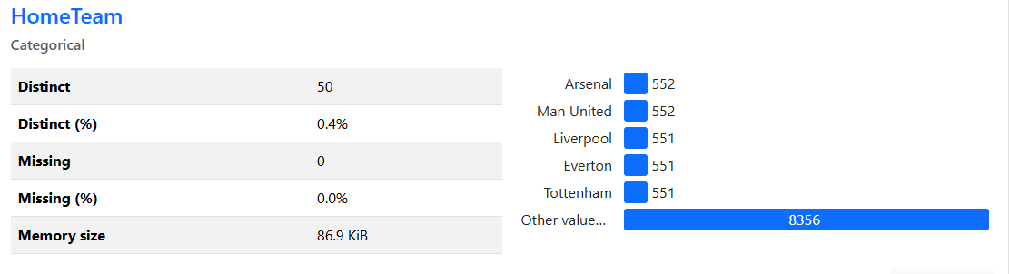
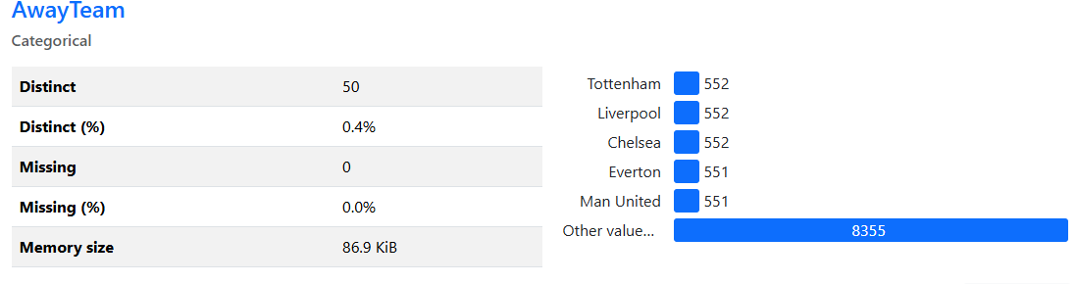
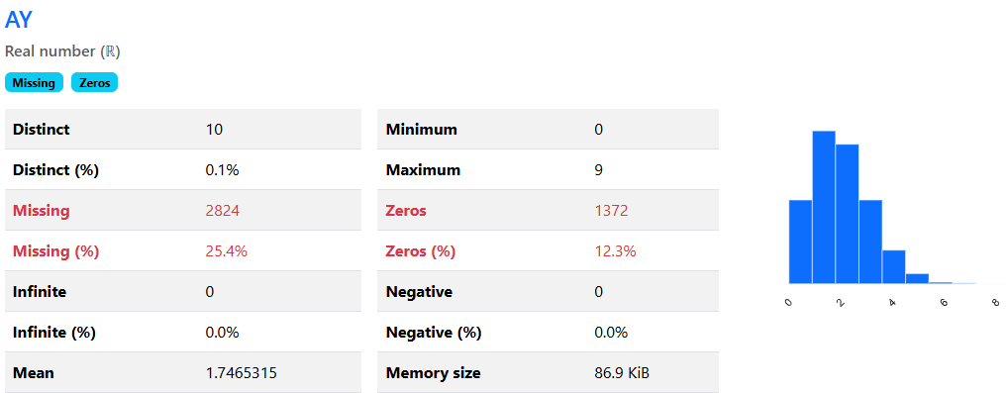

Slide 7
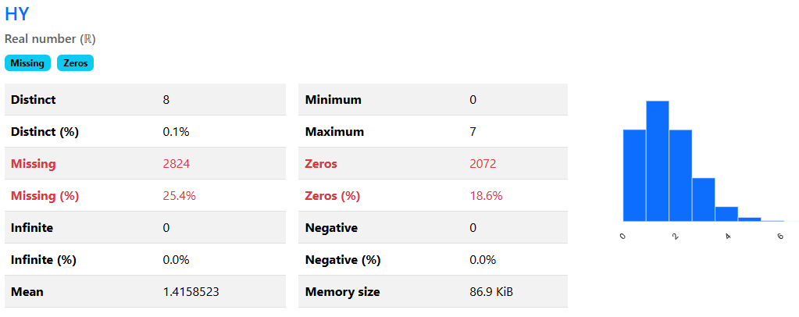
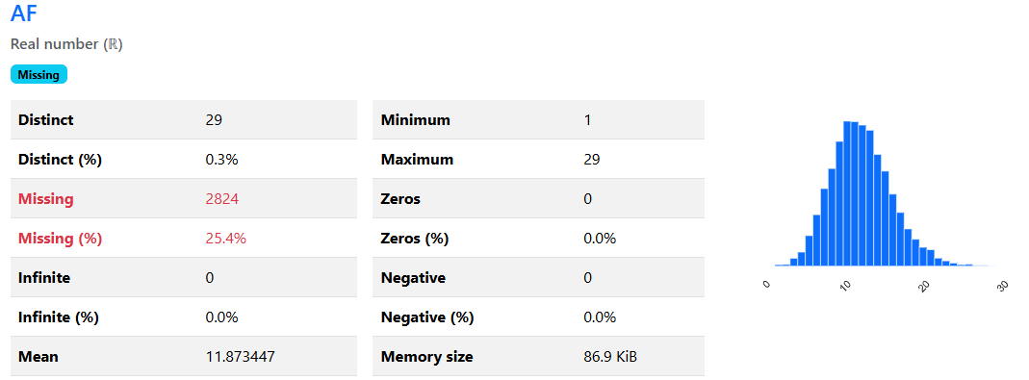
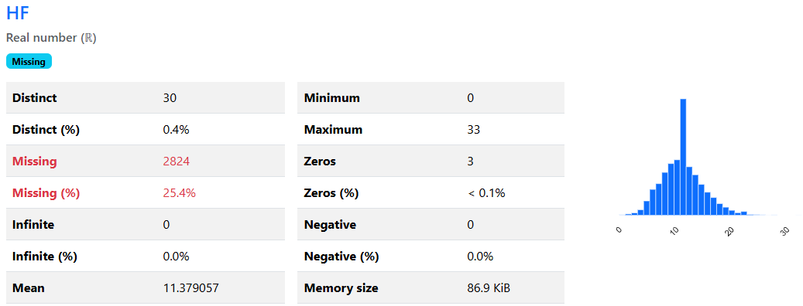

Slide 8
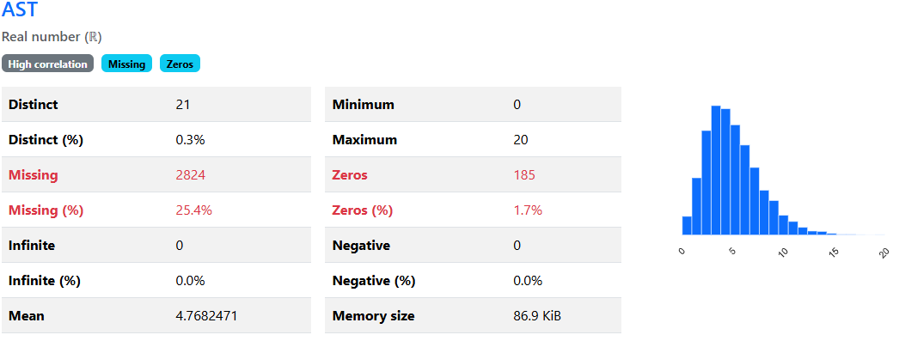
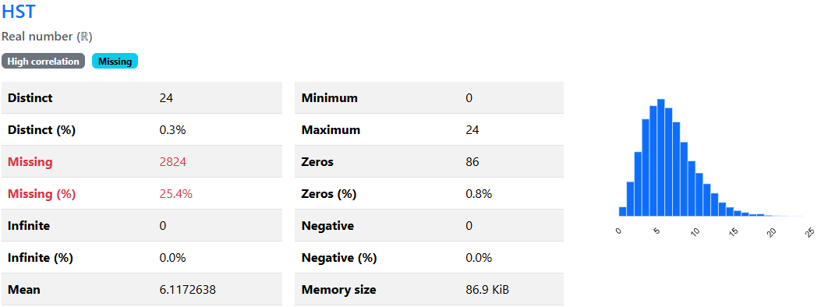

Slide 9
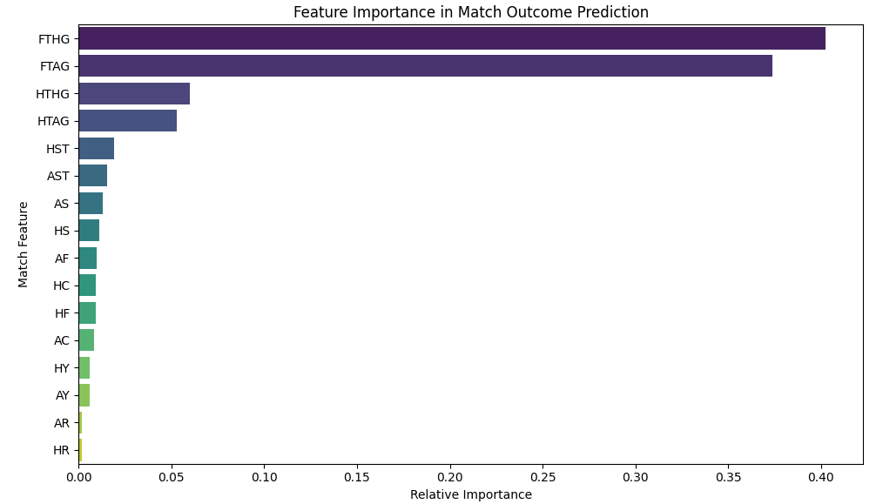

Slide 10
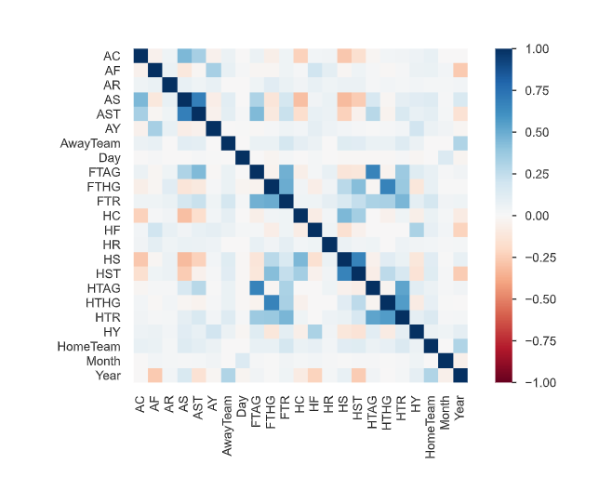

Slide 11
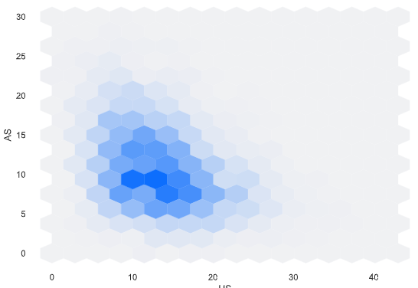
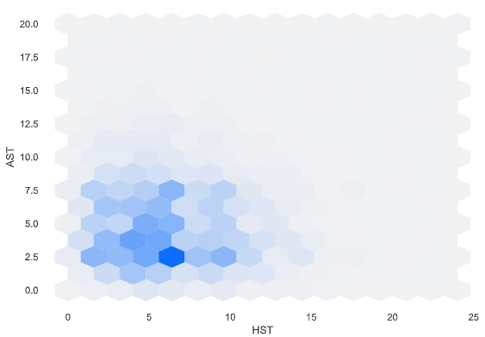
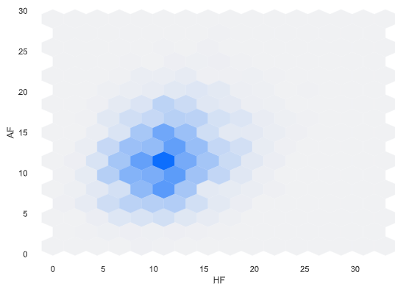
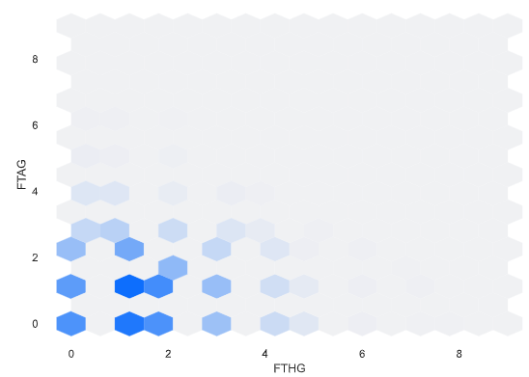

Slide 12
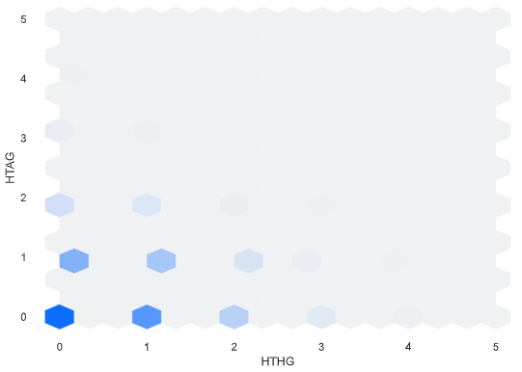
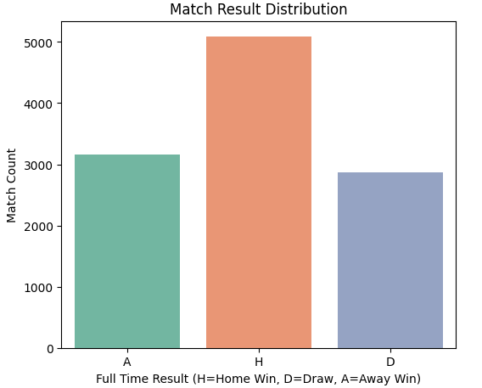

Slide 13
Machine Learning Models
1. Linear Regression
2. Decision Tree Regressor
3. XGBoost Regressor
Objective: Predict total goals or match outcome

Slide 14
Model Comparison (Regression)
Linear Regression: R² = 0.209, MAE = 0.64, RMSE = 0.76
Decision Tree: R² = -0.51, MAE = 0.75, RMSE = 1.05
XGBoost: R² = 0.15, MAE = 0.65, RMSE = 0.78
Best Model: Linear Regression (based on R² and CV RMSE)

Slide 15
Key Insights
Home advantage is statistically significant
Cards and fouls have mild negative impact on results
Shots on target are a strong predictor of match outcome
Simple models can partially predict outcomes but with limited accuracy

Slide 16
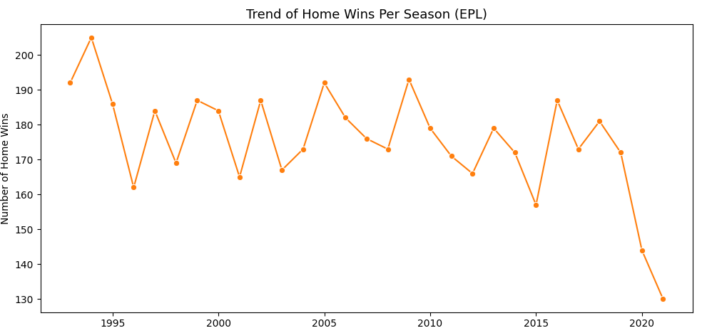

Slide 17
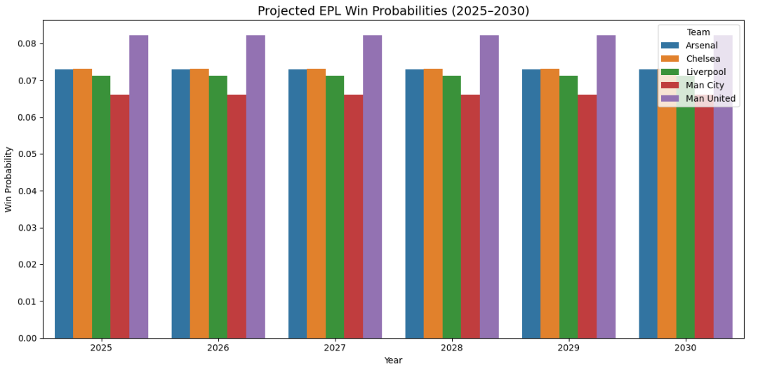

Slide 18
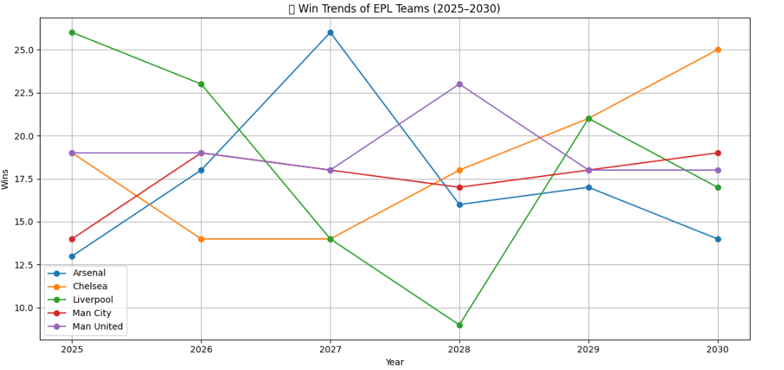

Slide 19
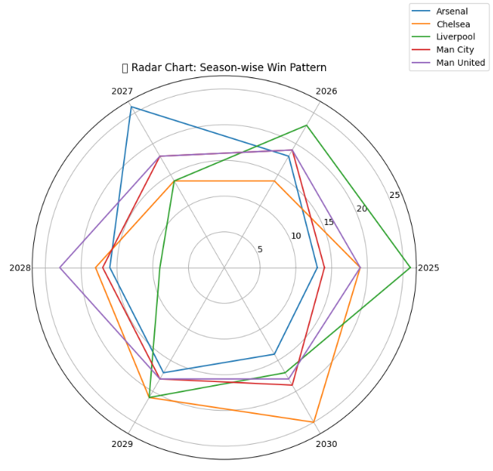

Slide 20
Conclusion & Future Scope
EPL data reveals rich match patterns and influencing factors
Model performance suggests potential but room for improvement
Future work: classification (win/loss/draw), include team form & player stats

